Slide 1
The James Hutton Institute’s Potato Diesase Diagnostic Tool
A low cost infield diagnostic tool that aims to further strengthen sustainable potato production

Slide 2
Project Aim
Aim of the project is to develop a diagnostic phone application to aid the field diagnosis of potato disease for the James Hutton Institute Malawi potato project.

Slide 3
Background
Professor Lesley Torrance is the leader of the cell and molecular science group at the James Hutton Institute.
Runs a project on strengthening potato production in Malawi.
The project has had several achievements.
Aims for this application to further strengthen potato production.

Slide 4
Specification
Requirements:
Searchable glossary
In field test videos in application
Decision support tool
Zoom into images
Image sharing
Update data in application
Non- Functional Requirements:
Must work offline
Must not use a lot of battery
The application should be scalable
Android or Iphone

Slide 5
Design Decisions
Agile method – 2 sprints – 7 days for each sprint
Android application.
SQLite database.
PHP based website.

Slide 6
Sprint’s
Sprint 1:
Searchable glossary
Test videos in the application
Sprint 2:
Changes from sprint 1
Decision support tool
Zoom functionality
Mock website with possibility of update

Slide 7
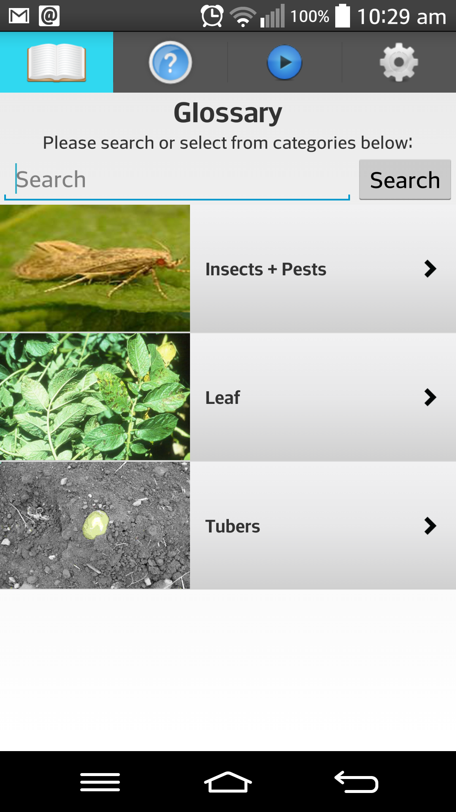
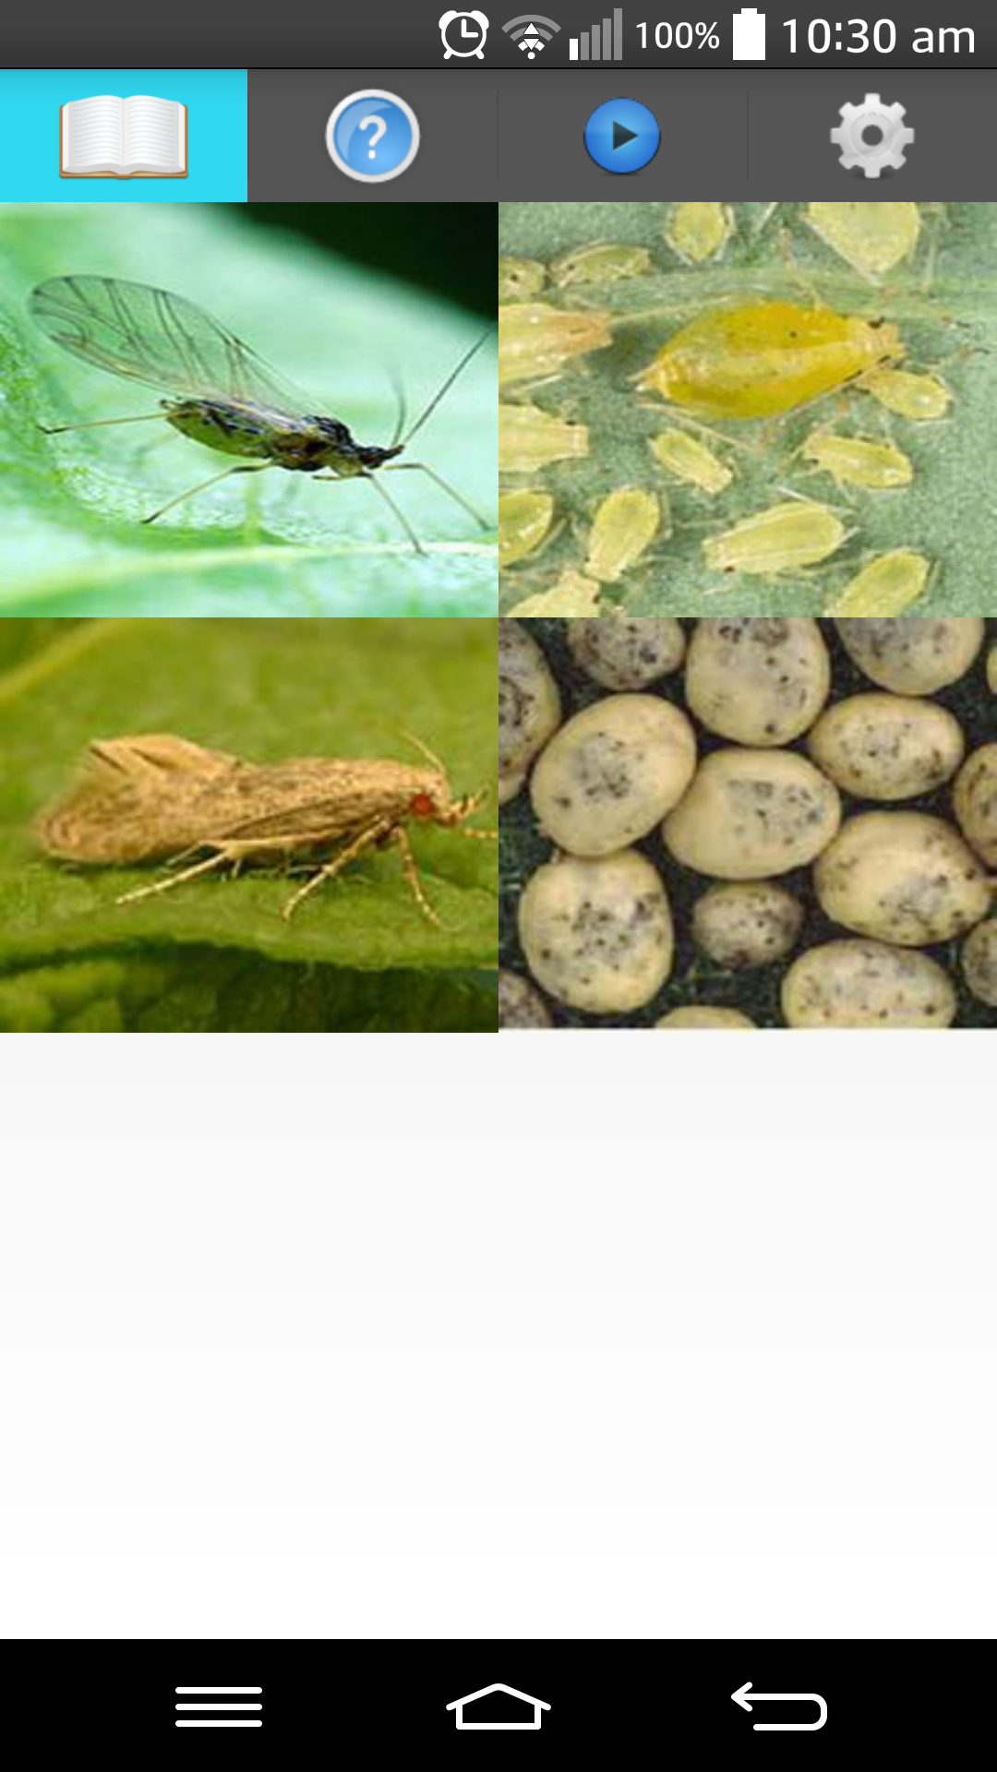
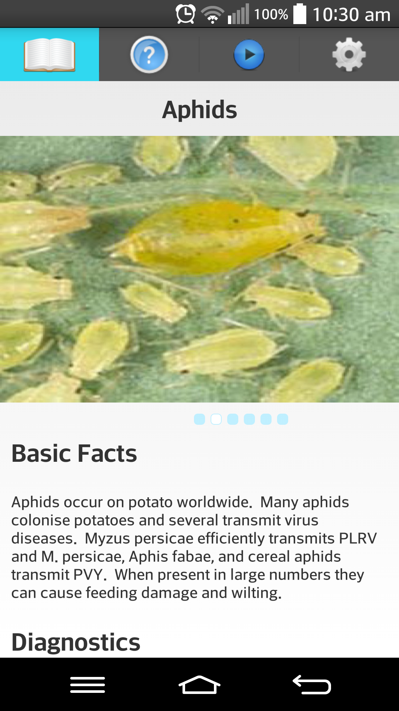
Demo

Slide 8
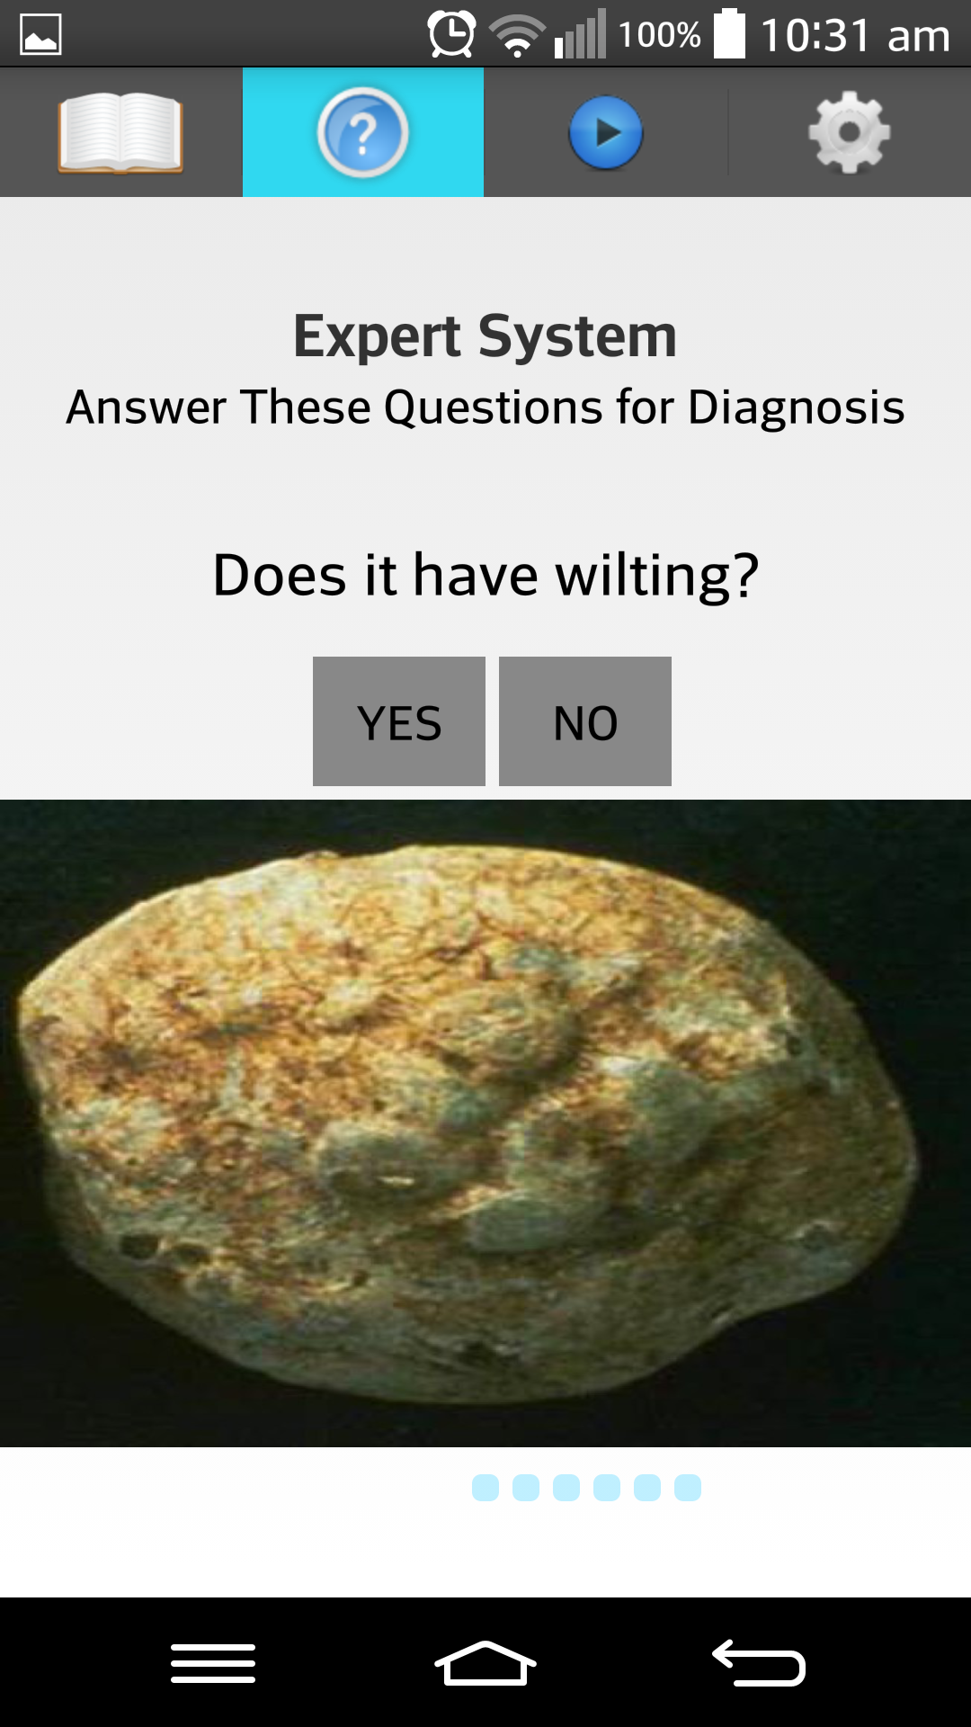
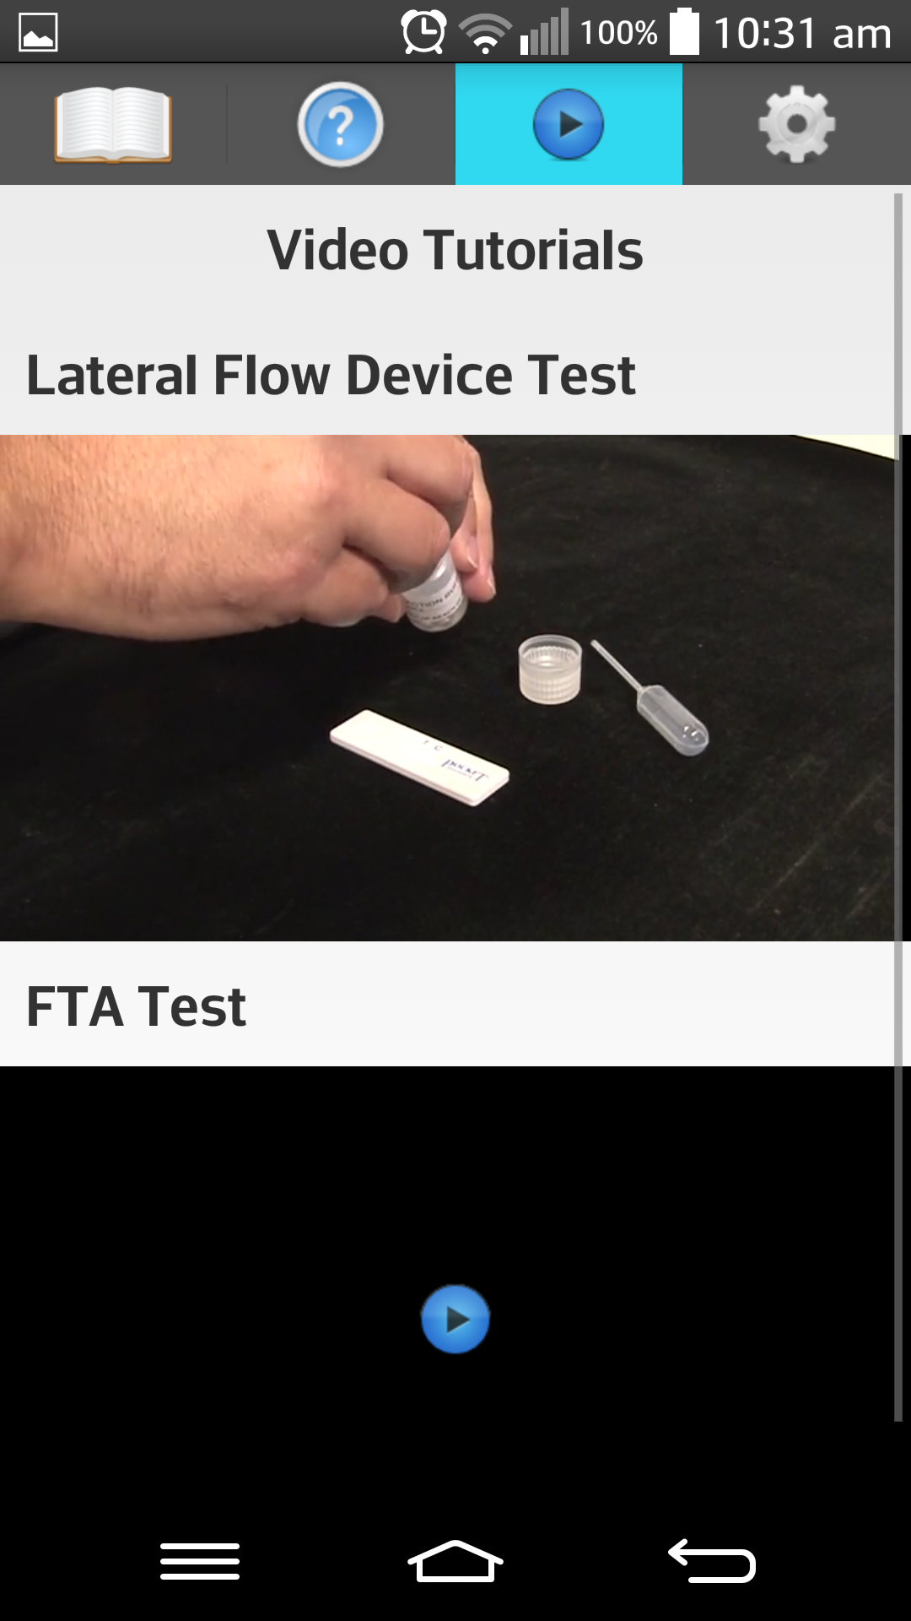
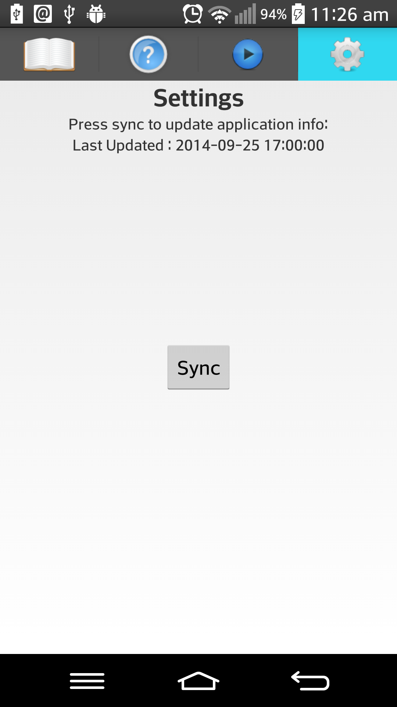
Demo

Slide 9
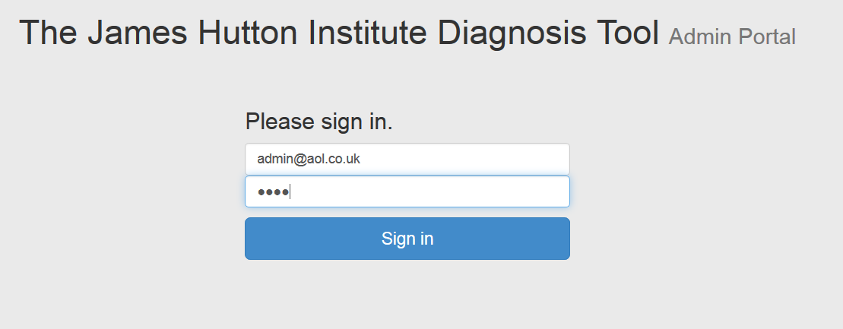
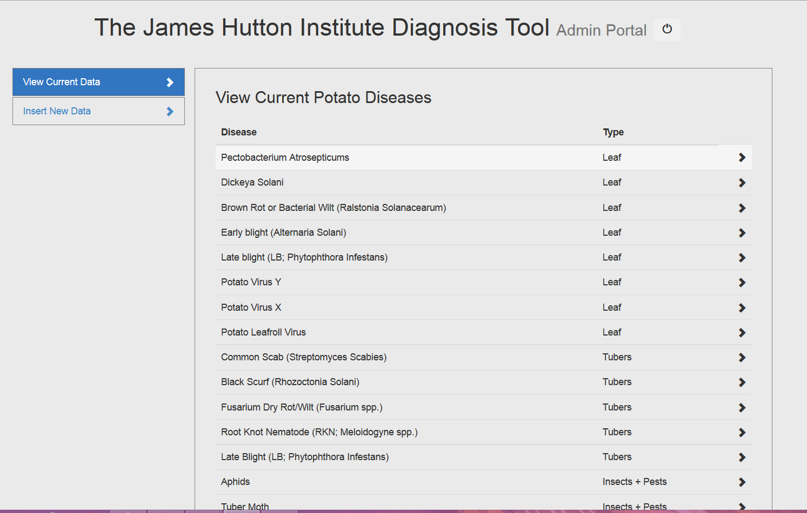
Demo
Screenshots

Slide 10
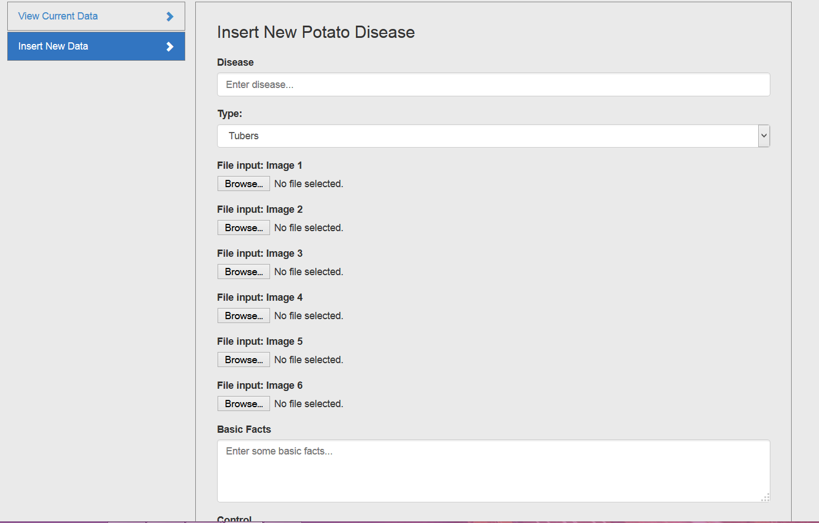
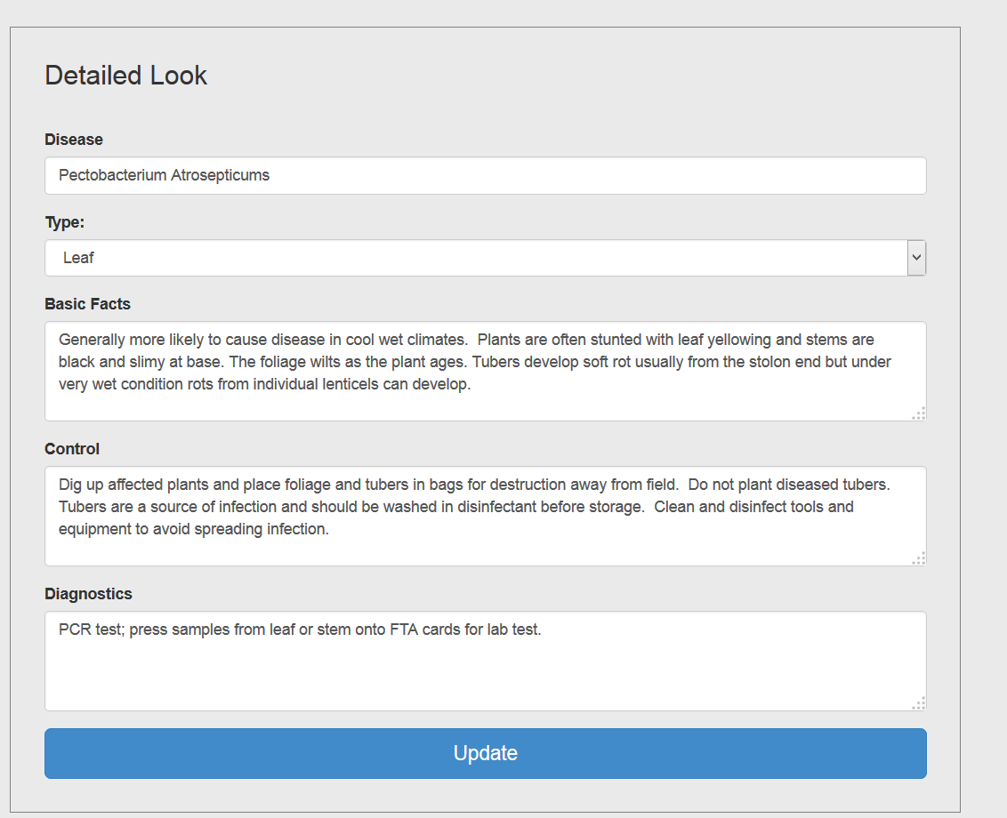
Demo

Slide 11
User Testing
10 participants ranging from ages 21 – 50.
User testing – Comments + SUS to evaluate testing
Average SUS score of 81.3 giving us a grade A

Slide 12
Reflection
Significant improvement on technical skills
Real world industry experience
Increased knowledge of potato disease
Personal development skills from the provided sessions.

Slide 13
Future Work
Improvement on website and syncing.
Working with the James Hutton Institute to improve the expert system.
Building on feedback given from user testing.
Thanks for listening. Any questions ?

